Slide 1
Word2vec
Advance NLP

Slide 2
Vectorization
Deeper understanding of w2v
Basic w2v function & Similarity using w2v
Word2vec properties in spaCy
Case study

Slide 3
Vectorization
Vectorization is a technique of converting text into numbers .
Machine can only understand numbers, hence we need to convert text into numbers.
Tf-idf, one-hot encoding, bag of words, w2v are popular technique of vectorization.
Vocabulary
King, Queen, Man, Woman, Child
King
1 | 0 | 0 | 0 | 0
Queen
0 | 1 | 0 | 0 | 0
Child
0 | 0 | 0 | 0 | 1
One hot-encoded Vector representation of words.
06

Slide 4
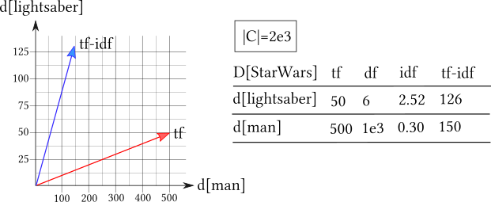
Vectorization: tf-idf
Tf-idf of word tokens

Slide 5
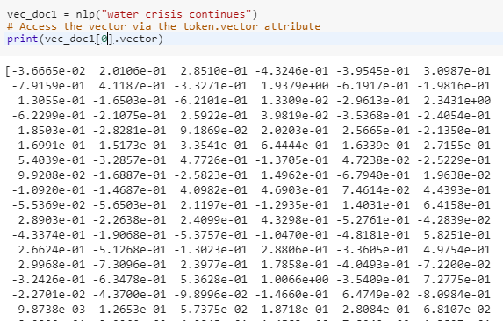
Vectorization: Word2Vector
This is an unique idea of presenting word into a set numbers ,called vector or in other words vector representation of words.
Word2Vec transforms a word into d-dimensional vector
Word2vec is a two-layer neural net that processes text.
Its input is a text corpus and its output is a set of vectors
For ex, the word ‘water’ has vector representation of 300 numbers.

Slide 6
Word embedding
Word embeddings are a class of techniques where individual words are represented as real-valued vectors in a predefined vector space.
Each word is mapped to one vector and the vector values are learned in a way that resembles a neural network.
Key to the approach is the idea of using a dense distributed representation for each word.

Slide 7
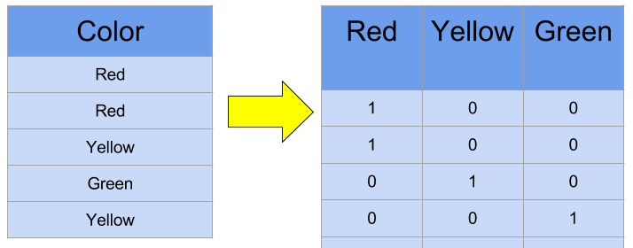
Why word embedding
Primarily One-hot has a major problem;
Each word is represented by a real-valued vector, often tens or hundreds of dimensions.
This is contrasted to the thousands or millions of dimensions required for sparse word representations, such as a one-hot encoding.
One-hot produces a very sparse data table with a very high number of 0s, which might be a problem for training certain machine learning algorithms.
Notes:
Vectorization

Slide 8
Vectorization
Deeper understanding of w2v
Basic w2v function & Similarity using w2v
Word2vec properties in spaCy
Case study

Slide 9
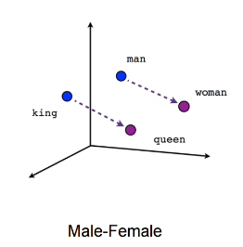
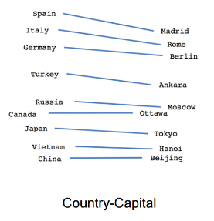
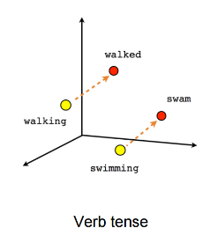
How does Word2Vec work?
Word2Vec concepts tries to establish a semantic relationship of a word with other word.
Here semantic relationship means relating or similar relationship.

Slide 10
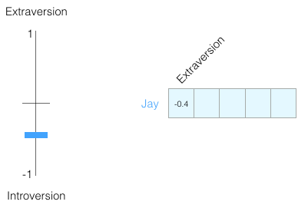
How does Word2vector work?
Let’s say Jay has -0.4 Extraversion score.
It means that Extraversion of Jay is represented by a number of -0.4.

Slide 11
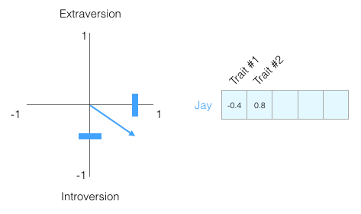
How does Word2vector work?
Since humans have many other traits, so we can score the traits accordingly.
And that’s how we can have numbers for each trait(word in this case).
Since each word has a particular weight and direction, we can say that each number has vector representation.

Slide 12
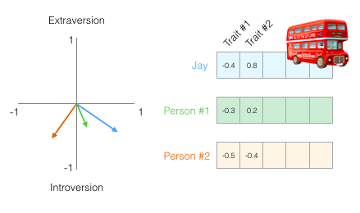
How does Word2vector work?
We can now say that this vector partially represents Jay’s personality.
The usefulness of such representation comes when you want to compare two other people to Jay.
Say Jay gets hit by a bus and he needs to be replaced by someone with a similar personality.
In the following figure, which of the two people is more similar to Jay?

Slide 13
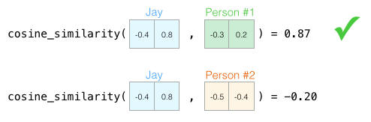
How does Word2vector work?
When use cosine similarity ,we find that person1 is close to Jay based on higher cosine similarity.
Notes:
Cosine similarity

Slide 14
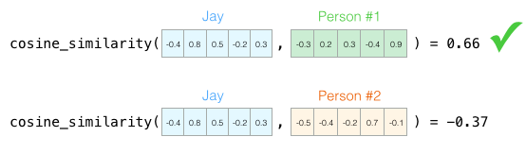
How does Word2vector work?
Though lower dimension captures minimum information.
But cosine similarity can work with any dimension.

Slide 15
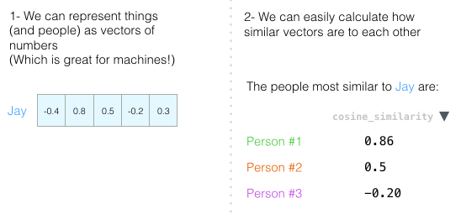
Usefulness of w2v

Slide 16
Purpose and usefulness of Word2Vectors
The purpose and usefulness of Word2vec is to group the vectors of similar words together in vectorspace.
That is, it detects similarities mathematically(default is cosine).
Word2vec creates vectors that are distributed numerical representations of word features, features such as the context of individual words.

Slide 17
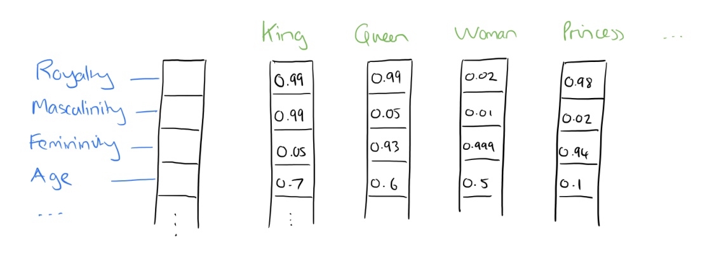
Similarity in Word2Vectors
Cosine similarity is used to measure similarity between the words. 1 denotes two words are completely similar whereas 0 denotes they are complete dissimilar.
In the below example, the degree of relationship between Royalty and King, Queen, Princess is 0.99 because they are very similar.
Whereas degree of relation between Femininity and King is 0.05(Very dissimilar).

Slide 18
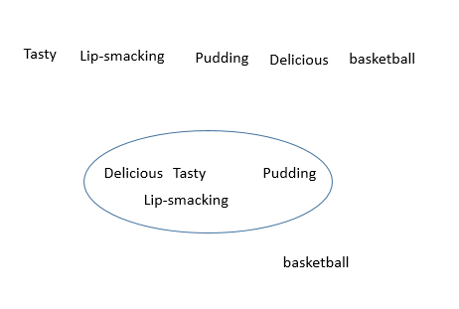
Let’s take another example of Word similarity
Word2Vec automatically finds similarity and cluster the words based on being similar.
Basketball is the most dissimilar choice in the example below.
Vector representation of the words Delicious, Lip-smacking , Pudding , Tasty capture much information about one another.
In other words the vectors of the words are very similar.

Slide 19
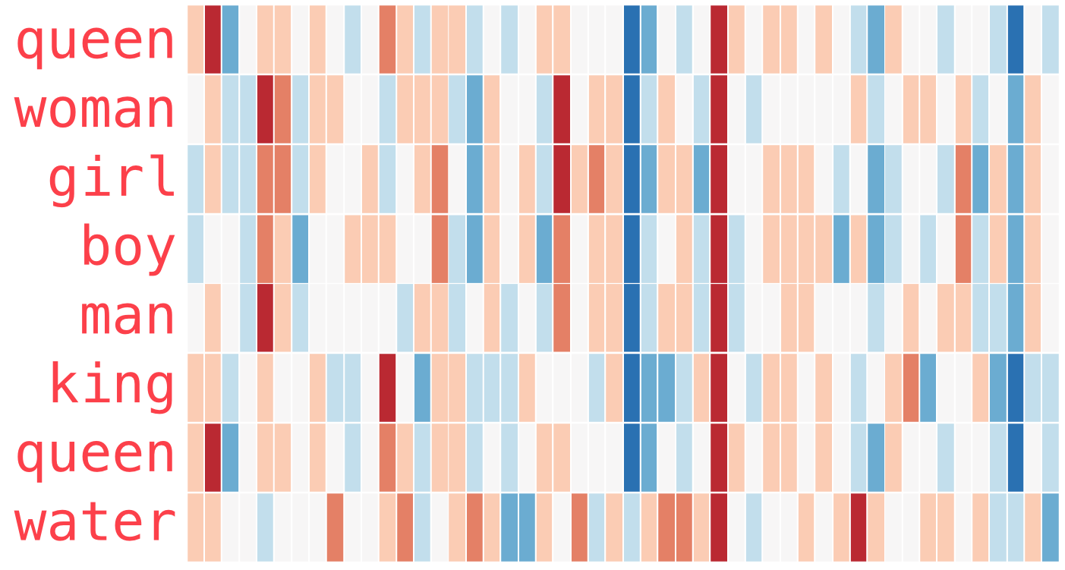
Similarity of words
If we take a look at the color coded vector of each word, we will find that Queen and king have similar color representation and in the same way girl→ boy, woman→ man
08

Slide 20
Vectorization
Deeper understanding of w2v
Basic w2v function & Similarity using w2v
Word2vec properties in spaCy
Case study

Slide 21
Word2Vec is a Language Model technique that works on two algorithms;
CBOW(continuous bag of words)
Skip-Gram

Slide 22
Window size in word2vec
W2V finds similarity based on the neighboring words appearing with the target word.
Find probability of a word being ‘nearby word’
Context, Target pair
The | Sun | rises | in | the | east
(The, sun)
The | Sun | rises | in | the | east
(Sun, The) (Sun, rises)
The | Sun | rises | in | the | east
(rises, Sun) (rises, in)
10

Slide 23
WORD2VEC WINDOW SIZE
We define window size when build a w2v model. Window size helps us know how many words we want as neighbors to the target words.
The | Sun | rises | in | the | east
Window size = 1
(in, rises) (in, the)
Window size = 2
(in, rises) (in, Sun) (in, the) (in, east)
We will use window size to how useful it is in Language Modeling
11

Slide 24
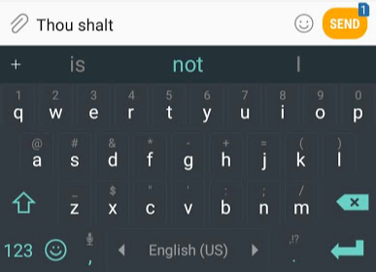
Language modeling
Language modeling is a technique in which we give input(s) to predict the output.
For ex, Thou shalt are two inputs, which will come next to it?
Obviously a certain word and that word is predicted with a number of other words with probabilities.
Probability remains highest for the correct word.

Slide 25
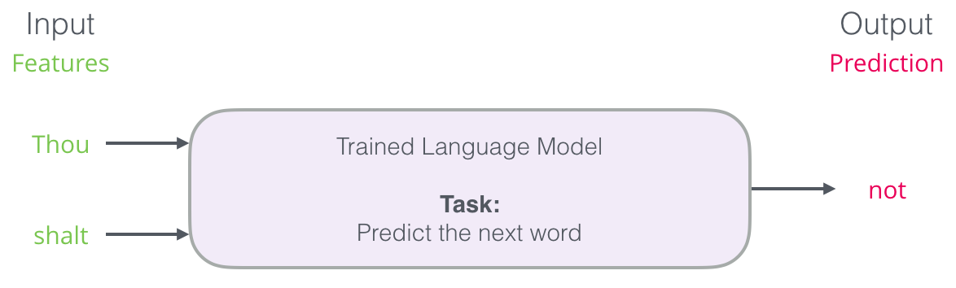
Language modeling
We can think our Language model like this.

Slide 26
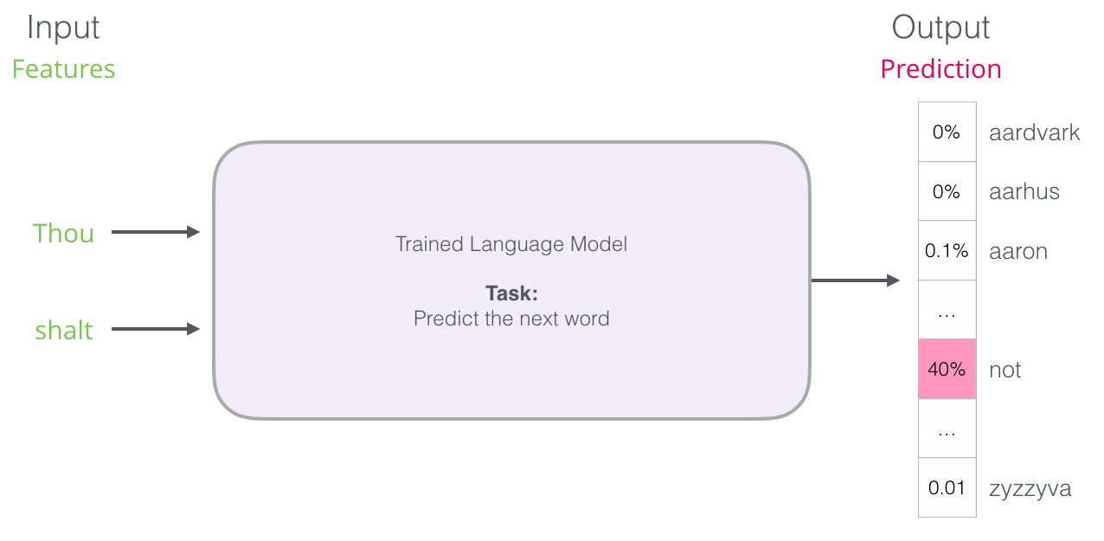
Language modeling
The model doesn’t output only one word.
It actually outputs a probability score for all the words it knows.
The keyboard has to present a word with highest probability score.

Slide 27
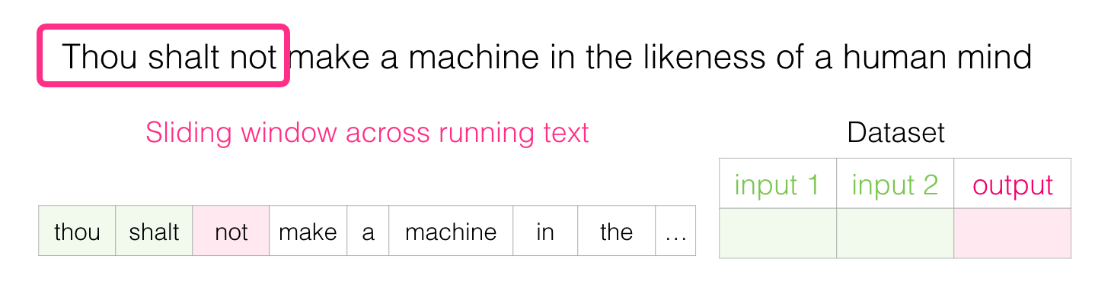
CBOW(Continuous Bag of Words)
Target /Output word: A single word in a line of text.
Context word: A set of words

Slide 28
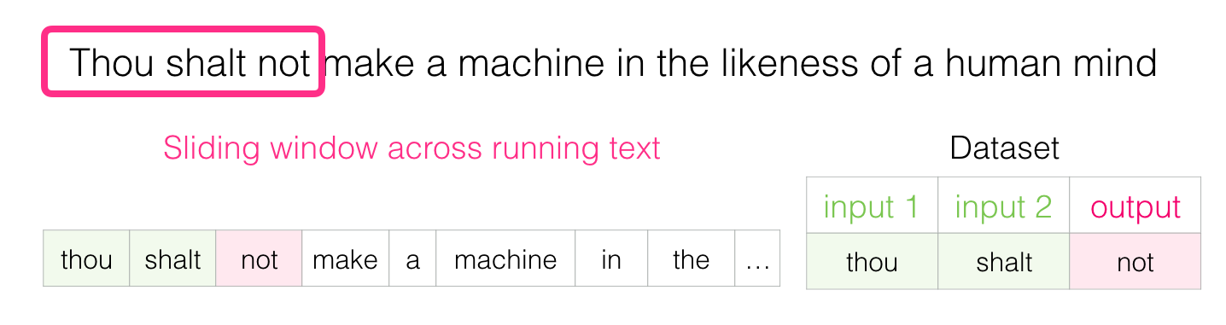
CBOW(Continuous Bag of Words)
In the example below we take two inputs(thou, shalt) and predicted output is ‘not’.
That’s how next word is predicted.

Slide 29
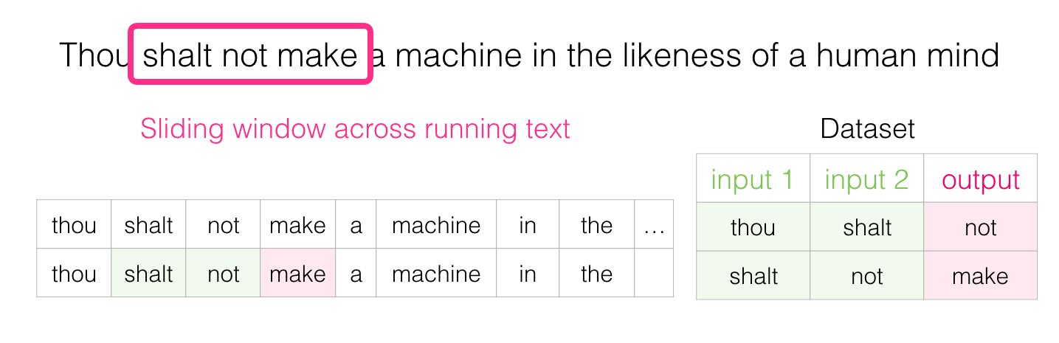
CBOW(Continuous Bag of Words)
We then slide our window to the next position and create a second sample.

Slide 30
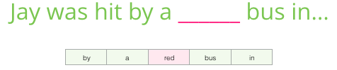
Skipgram
Instead of taking a context or more than a word as input we will take only one word as input and predict the context(a number of words) as output.

Slide 31
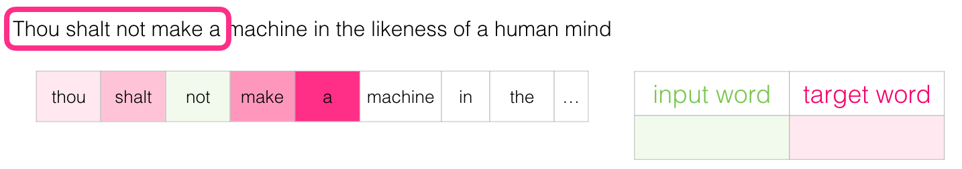
Skipgram
In this skipgram example, we train Thou shalt not make a

Slide 32
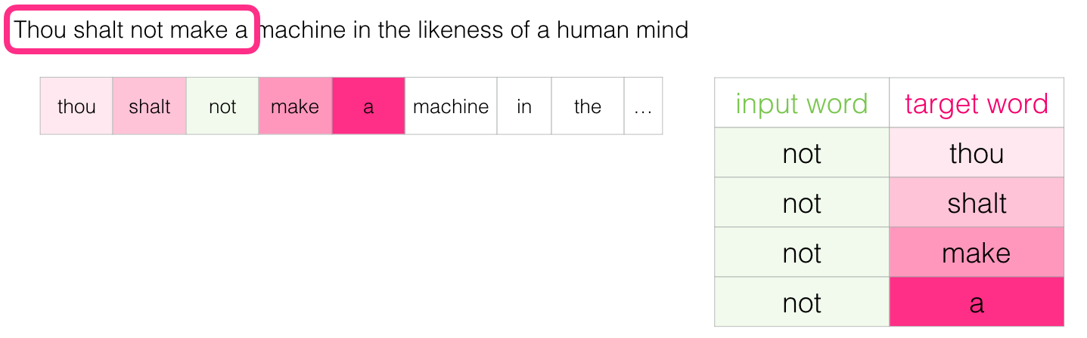
Skipgram
where we insert ‘not’ as our input, and we will get the context as output.

Slide 33
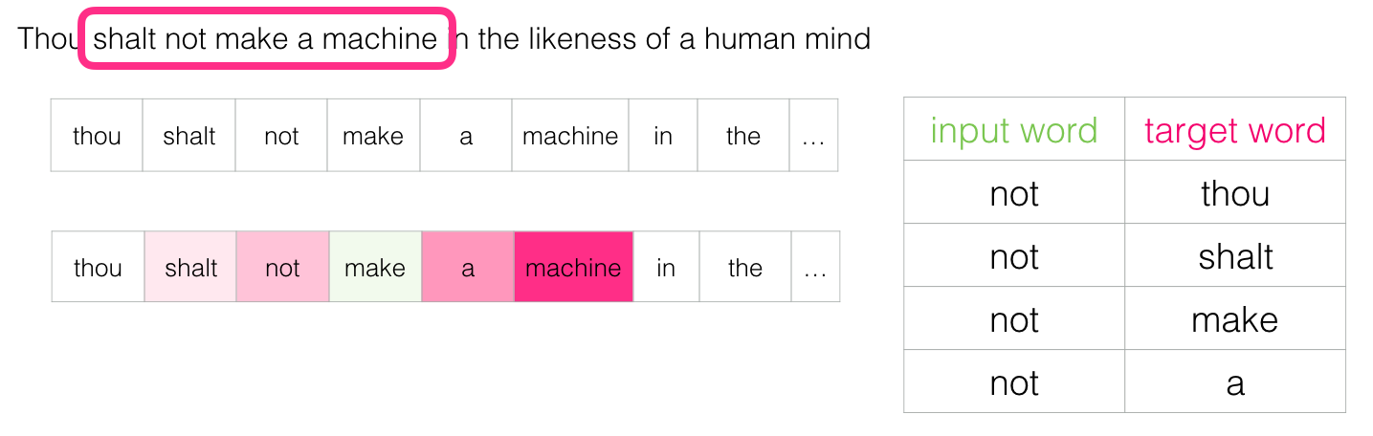
Skipgram
We slide our example to next position.

Slide 34
Skipgram with Negative sampling
When we train skipgram model ,the output is n-dimensional words with probability.
If we 10000 words, we will get 10000 probabilities. All the probabilities are summed up to 1.
But we want word(s) with high probability.
It’s not possible to update 10000 probabilities using optimizer.--- Time consuming.
Instead we take small number of words for which word the weights will be updated to 0.
And that’s how we can adjust actual weight for the input word.
In negative sampling ,we calculate loss for some randomly chosen words, then based on the loss, we perform optimization(SGD, Adam)

Slide 35
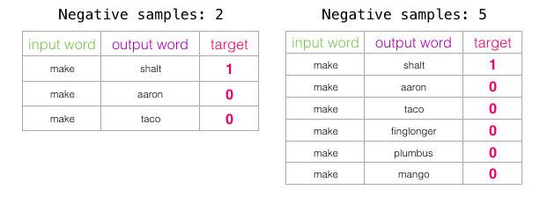
Window size and Negative sampling
The original paper prescribes 5-20 as being a good number of negative samples.
It also states that 2-5 seems to be enough when you have a large enough dataset.
The Gensim default is 5 negative samples.

Slide 36
Vectorization
Deeper understanding of w2v
Basic w2v function & Similarity using w2v
Word2vec properties in spaCy
Case study

Slide 37
spaCy to predict similarity
Similarity is determined using word vectors.
It mainly uses cosine similarity(Default).

Slide 38
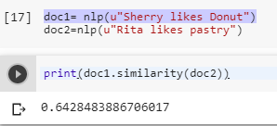
spaCy to predict similarity
Sentence level similarity
spaCy's default word vectors assign a very high similarity score to “Sherry likes Donuts” and “Rita likes pastry".
Notes:
# spacy—similarity
# genism- similarity

Slide 39
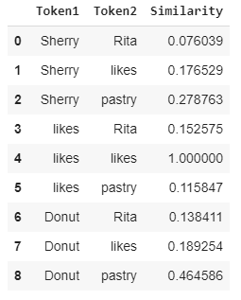
spaCy to predict similarity
Word level similarity
spaCy identifies similarity between the words in two sentences.
The similarity measure is cosine similarity

Slide 40
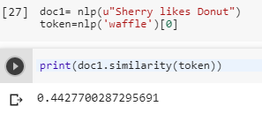
spaCy to predict similarity
Comparing similarity between token and document
spaCy identifies similarity between the token in document.

Slide 41
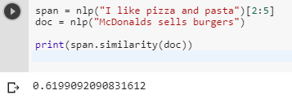
spaCy to predict similarity
Comparing similarity between span and document
spaCy identifies similarity between the span and document.

Slide 42
Usefulnes of similarity
Predicting similarity can be useful for many types of applications.
For example, to recommend a user similar texts based on the ones they have read.
It can also be helpful to flag duplicate content, like posts on an online platform.

Slide 43
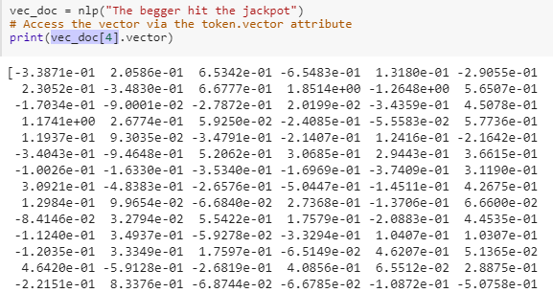
Word2vector of spaCy
spaCy’s en_core_web_md model enables us to access to 300 dimension vector of any token.
For example, the vector representation of word ‘jackpot’ given in the diagram beside.

Slide 44
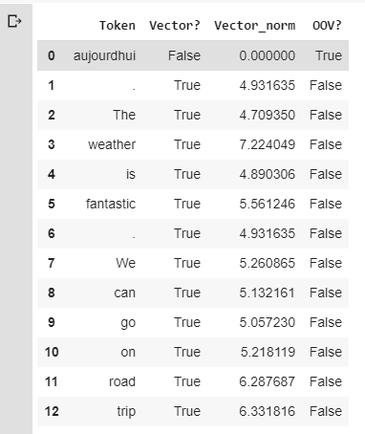
Word2vector of spaCy: Some more properties of vectors
The table shows if each token is a vector.
Vector norm: The L2 norm of the token’s vector (the square root of the sum of the values squared)
OOV: Check if a token is out of vocab.

Slide 45
Vectorization
Deeper understanding of w2v
Basic w2v function & Similarity using w2v
Word2vec properties in spaCy
Case study

Slide 46
Case study
Please refer to the hands-on notebooks

Slide 47
Reference slides

Slide 48
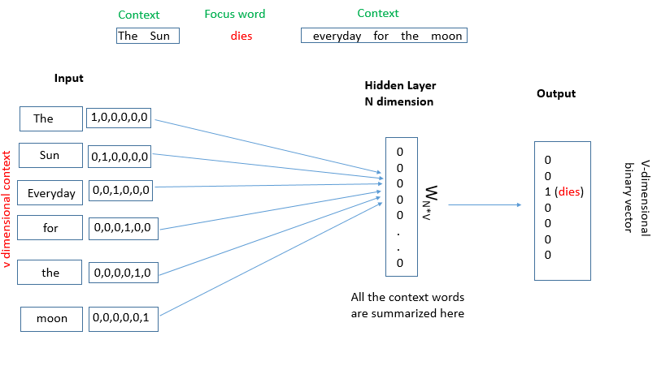
CBOW(Continuous Bag of Words)
Target word: A single word in a line of text.
Context word: A set of words
07

Slide 49
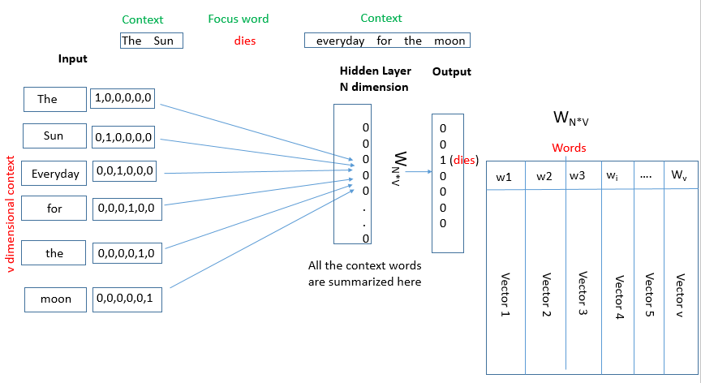
CBOW(Continuous Bag of Words)
Focus word is dies & context words are neighboring words like the , sun, everyday ,for, moon.
CBOW tries to predict the focus word based on the context(input).
08

Slide 50
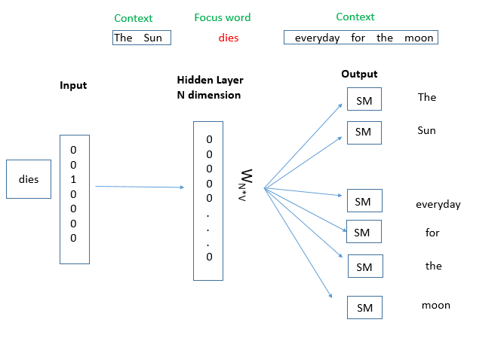
SKIP-GRAM
Skip-gram is the flip of CBOW. Here we predict the context given a focused word.
The focus word is represented on a N-dimensional hidden layer and from hidden layer a number of context words are predicted using a number of softmax(SM)classifier.
08

Slide 51
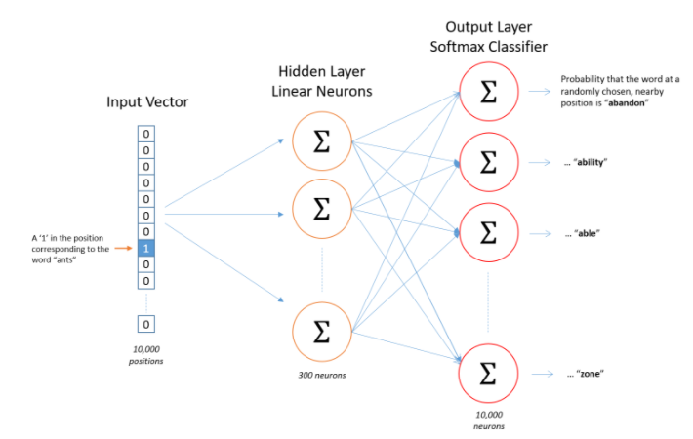
More comprehensive Understanding of Skip-Gram model

Slide 52
CBOW Vs SKIP-GRAM
CBOW vs SKIPGRAM
In skip-gram a number of softmax classifiers are required where as in CBOW only one Softmax is required that's why Skip-gram is computationally more expensive than CBOW ,hence CBOW is faster than skip-gram.
CBOW works better frequently occurring words where as skip-gram works better in opposite manner.
08

